Slide 1
Agile Methodologies AND Jira
- By Praveen Reddy

Slide 2
Software Development Life Cycle(JIRA)
Introduction:
Jira Software is a work management tool for software teams that need to organize and track their work.
Jira is incredibly flexible and can be customized to work with your team's unique workflow, meaning teams of all kinds can enjoy increased productivity and visibility as they march toward releasing amazing software.
It is not a full form, the name 'JIRA' comes from the Japanese word 'Gojira' meaning 'Godzilla’.
The original black and white Godzilla films is a hit among Japanese developers and they called the tool 'Gojira’ later the 'go' dropped and the tool was called simply as JIRA.

Slide 3
Features of JIRA
Issue Tracking
Customizable Workflows
Agile Me
Project Management
Reporting and Dashboards
Mobile Accessibility
Service Management

Slide 4
Purpose of JIRA
The purpose of Jira is to serve as a versatile and powerful project management and issue tracking tool that helps teams and organizations manage their work more efficiently.
Issue Tracking: Jira's core purpose is to track and manage issues, bugs, tasks, and work items throughout their lifecycle. It provides a structured way to create, prioritize, assign, and monitor work items, ensuring that nothing falls through the cracks.
Project Management: Jira is used for project management across various domains, including software development, IT service management, marketing, HR, and more. It allows teams to plan, execute, and monitor projects, tasks, and initiatives effectively.
Agile Software Development: Jira is widely used by Agile software development teams to support Agile methodologies like Scrum and Kanban. It facilitates sprint planning, backlog management, and the visualization of work on Agile boards.

Slide 5
Benefits of JIRA in SDLC
Issue Tracking: JIRA's core functionality is its robust issue tracking system, allowing teams to create, prioritize, and manage tasks, bugs, user stories, and more.
Customizable Workflows: JIRA enables you to define and customize workflows to match your team's unique processes, ensuring issues progress through the appropriate stages efficiently.
Project Management: You can create and manage multiple projects within JIRA, each with its own settings, permissions, and configurations.
Agile Support: JIRA offers comprehensive support for Agile methodologies, including Scrum and Kanban boards, sprint planning, and backlog management.
Dashboards and Reporting: Users can create personalized dashboards with widgets and gadgets to monitor project progress and view important metrics. JIRA also provides reporting features for generating project reports.

Slide 6
JIRA in Action
Issue Creation: Users initiate the action by creating new issues in JIRA. These issues can represent tasks, bugs, new features, user stories, or any work item relevant to the project.
Issue Assignment: After creating an issue, it's assigned to a team member or a specific role within the team. This assignment ensures that someone is responsible for addressing the issue.
Issue Workflow: JIRA uses customizable workflows to define the stages and steps an issue goes through from creation to completion. Workflows help teams manage and track the progress of tasks.
Agile Boards: For Agile teams, JIRA provides Scrum and Kanban boards. These boards allow team members to organize and manage work visually, plan sprints, and move tasks through different stages of development.
Task Prioritization: Issues can be prioritized based on their importance and urgency. This helps teams focus on critical tasks and allocate resources accordingly.

Slide 7
Advantages AND Disadvantages IN JIRA
Advantages
Disadvantages
Issue Tracking
Customization
Agile Support
Integration
Automation
Reporting and Analytics
Complexity
Cost
Steep Learning Curve
Performance Issues
Limited Free Version
User Interface

Slide 8
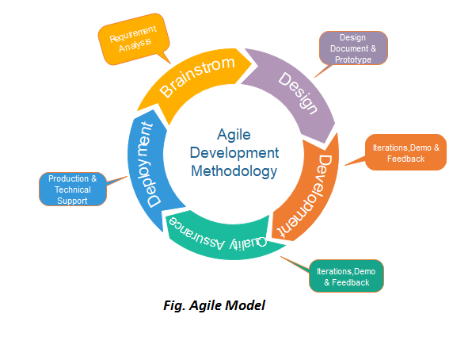
Agile Methodologies

Slide 9
Introduction to Agile
Agile is an iterative and incremental approach to project management.
It focuses on flexibility, collaboration, and delivering value to customers.
Agile methodologies prioritize individuals and interactions, working software, customer collaboration, and responding to change.

Slide 10
Agile Principles
Twelve principles behind the Agile Manifesto, Some key principles are,
Customer satisfaction through early and continuous delivery
Embrace Changing Requirements throughout the development process
Frequent delivery of working software
Enable face-to-face interactions
Simplicity

Slide 11
Agile Frameworks
Scrum:
Scrum Framework: Scrum defines roles (Product Owner, Scrum Master, Development Team), events (Sprint, Daily Scrum, Sprint Review), and artifacts (Product Backlog, Sprint Backlog).
Iterative Approach
Transparency
Collaboration
Benefits: Rapid delivery, better team collaboration, and adaptability to changing requirements.

Slide 12
Lean Software development:
Lean emphasizes eliminating waste, maximizing value, and optimizing flow in software development.
Key Concepts: Value stream mapping, minimizing work in progress (WIP), and continuous improvement.
Customer Focus
Benefits: Improved efficiency, reduced waste, faster delivery, and customer satisfaction.

Slide 13
Kanban:
Visualize Workflow
Limits Work in progress
Continuous Improvement
Flexibility
Benefits: Enhanced workflow visibility, reduced bottlenecks, improved efficiency, and quicker issue resolution.

Slide 14
Agile Practices
User Stories for Requirements
Iterative Development
Continuous Integration
Test-Driven Development (TDD)
Retrospectives for Improvement

Slide 15
Benefits of Agile
Faster Time-to-Market
Enhanced Customer Satisfaction
Adaptability
Transparency and Collaboration

Slide 16
Challenges in Agile
Managing Changing Requirements
Team Collaboration
Scaling Agile
Balancing Flexibility and Structure

Slide 17
Agile in Real World
Netflix:
Netflix relies on Agile for content development and recommendation algorithms, enabling them to deliver personalized content to millions of subscribers.
Agile at Amazon:
Amazon's web services (AWS) division uses Agile practices to rapidly innovate and release new cloud computing services.
Airbnb:
Airbnb uses Agile to continuously enhance its platform based on user feedback, resulting in frequent updates and improved user experiences.

Slide 18
Conclusion
Agile methodologies prioritize collaboration, adaptability, and value delivery.
Agile offers benefits such as speed, customer satisfaction, and adaptability to change.
Jira serves as an indispensable tool, facilitating Agile project management.
Jira supports Agile teams through planning, tracking, and customization.
Agile + Jira results in efficient, responsive, and ultimately successful project management.

Slide 19
References
https://youtu.be/8eVXTyIZ1Hs?si=BikpUME_0nv0CM68
https://www.smartsheet.com/comprehensive-guide-values-principles-agile-manifesto
https://premieragile.com/types-of-agile-frameworks/
https://www.atlassian.com/agile#:~:text=What%20is%20the%20Agile%20methodology,planning%2C%20executing%2C%20and%20evaluating
https://www.geeksforgeeks.org/what-is-jira-software/

Slide 20
Questions and Answers

Slide 21
THANK YOU
-Praveen Reddy

